Slide 1



Digital piracy of us content
Burton Clausen
DDI-13
November 2025
Notes:
My name is Burton Clausen and today we will be exploring digital piracy
--next

Slide 2

Table of contents
Project Overview
Exploratory Focuses
Cleaning
Visual Aides
Conclusion
Sources
Notes:
Here's a quick look at our agenda
--next

Slide 3
Overview
Digital piracy is a persistent issue impacting the film, and TV sectors, costing the U.S. billions annually.
Despite availability of legal platforms, high costs and content fragmentation drive piracy.
This exploratory data analysis observes trends and/correlations in pirated video files to identify what categories of video content are the most susceptible.
Exploratory Focuses
Which file was downloaded the most? Which director (collectively)
What is the average amount of time between theatrical release and instances of piracy?
How has piracy grown over the past three decades?
What correlations exist between upload time, the number of downloads, download rate, and IMDb rating?
Notes:
We all likely know what piracy is: the accessibility to digital entertainment without regard to copywrite laws which contributes to billions of dollars lost annually.
This exploratory data analysis observes trends and correlations into pirated video in the US to explore how it has grown over the years and observe correlations or trends relating to availability and popularity.
We will look at who's work was downloaded the most, what single work was downloaded the most, and some trends over time
--next

Slide 4
Cleaning and Preparation
Filtering - only content originating in the United States
Dropping the Dead Weight - eliminate columns which were of no use or held no interest
Formatting - Numbers were converted from strings, dates were converted and given a uniform format, and uniform runtimes were derived from several varying formats.
Removing Duplicates - by title, director, and release date to ensure valid duplicates
Filling the blanks - 'Not available’ for missing strings and mean values for numeric data.
Additional Engineering - New columns performing useful calculations were added before the entirety of the data was organized logically and sorted. Additional filters functions were created for analysis.
Notes:
Data preparation included filtering exclusively to US content, dropping unnecessary datapoints, formatting and fleshing out missing information and deduping to increase validity. Deduping was important because the same content experiences multiple uploads, but there are also many instances of vastly different content sharing the same title
--next

Slide 5
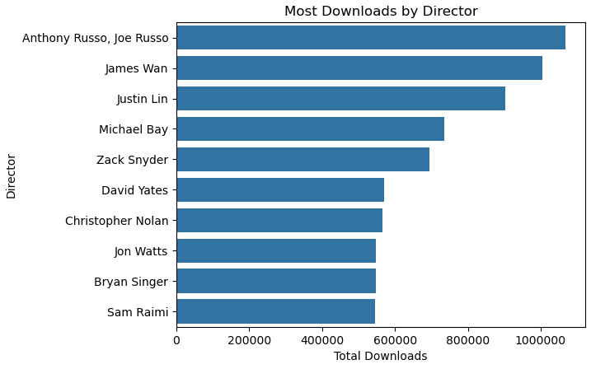
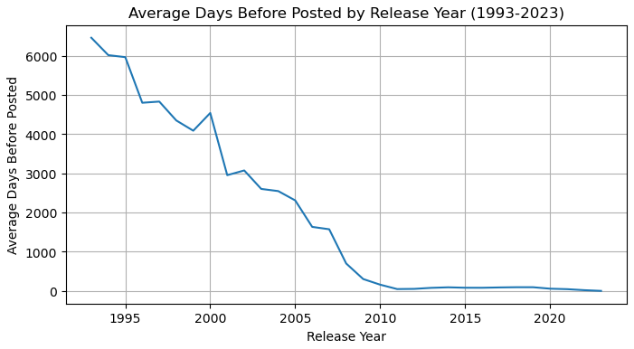
Which director’s collective works have been downloaded the most? –the Russo Brothers
All directors were active in mid-2010s
Many share work in similar genres
Early piracy efforts began in the late 1990s
Average days to upload approaches zero near 2012
The Digital Millennium Copyright Act (DMCA) was enacted in 1998
DCMA
Notes:
Here is a list of our top ten directors based on downloads of their collective works
On the bottom shows the decrease in average time between theatrical release dates and the date a video was available for download. Some data predated the internet and would heavily skew results, so this represents only data since the first video server went online in June 1993.
--next

Slide 6
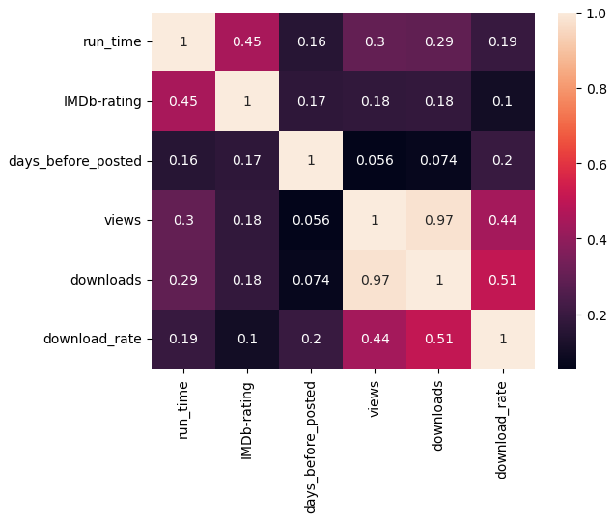
Correlations
Direct correlation with number of downloads compared to views
Not a strong correlation between IMDb rating and download_rate/popularity
Not a strong correlation between days_before_posted and the download_rate …worth exploring
Notes:
Here's a quick look at some relationships with numeric features. The strong correlation between the amounts of views a file receives and the amounts of times it is downloaded is incredibly strong.
I was surprised the correlation between the download rate and IMDb rating was not stronger, as popular content would logically have a higher rate for piracy.
I had also anticipated a stronger relationship of the days from release/upload and the download rate to be higher.
--next

Slide 7
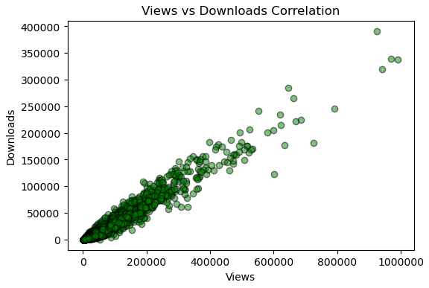
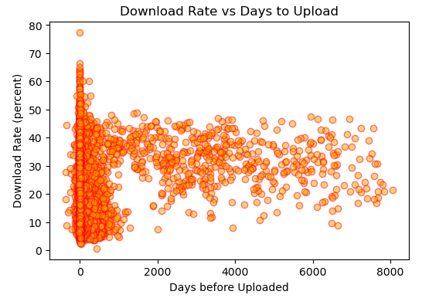
Correlations
LEFT: Representation of the observation above showing a very strong logical connection between views and downloads.
RIGHT: Most popular content IS uploaded shortly after release date, but there is an abundance of data posted after pirating sites gained popularity.
Notes:
On the left is our strongest correlation - a tight cluster of views to downloads. Makes sense if many visit the sites with specific content in mind.
On the right - Our most popular downloads DO have a quick upload time, seen by the highest third of data near that strong day zero line on the left.
The data is actually skewed because it includes entries when pirating was possible but before sites truly became mainstream. Data outside the main cluster ranges from 3 to 21 years. However, the technology existed, as all points represent content created after the first video server went online in June 1993.
--next

Slide 8
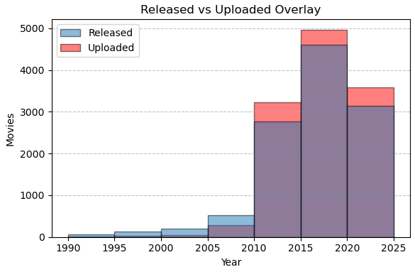
Correlations
TAKEAWAYS:
1 - From 1993 to 2009 the US produced more content than was supported by pirating sites
2 - Large uptick around 2010
Highspeed internet availability
DVD/Blu-ray quality content
3 - Pirated content outpaces Hollywood
3
Notes:
This overlay shows the number of theatrical releases compared to the number of videos uploaded, again, just during the time when uploading was possible.
Note the large uptick in 2010 where more content was pirated than produced, coinciding with popularity of higher quality content like Blu-ray and dvd as well as faster internet becoming more commercially available to facilitate piracy.
--next

Slide 9

Conclusion
Notes:
This concludes my data exploration project, thank you. At this time, I will accept any questions of feedback, but first….
--does anyone care to guess what the most downloaded video was?

Slide 10
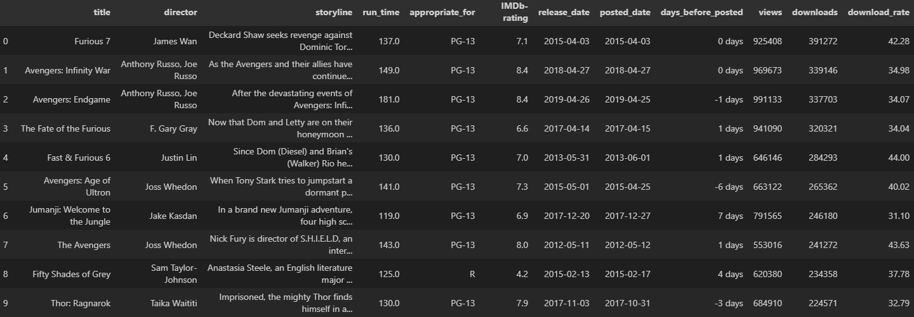
Top 10 Downloads

